Slide 1
MOVIE APPLICATION
PRESENTED BY
AMITOJ SINGH
RAJKARTHI
SUBHIKSHA

Slide 2
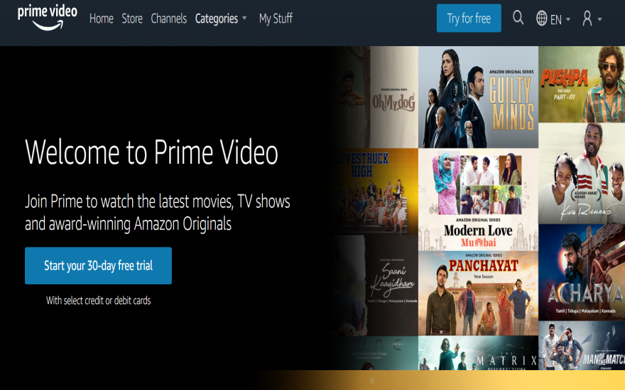
ABOUT MOVIE APPLICATION
Friendly user Interface
Smart Search
Streaming
Responsive to multiple devices
Store User Favourites List and Recommend to the user based on popularity and new releases.

Slide 3
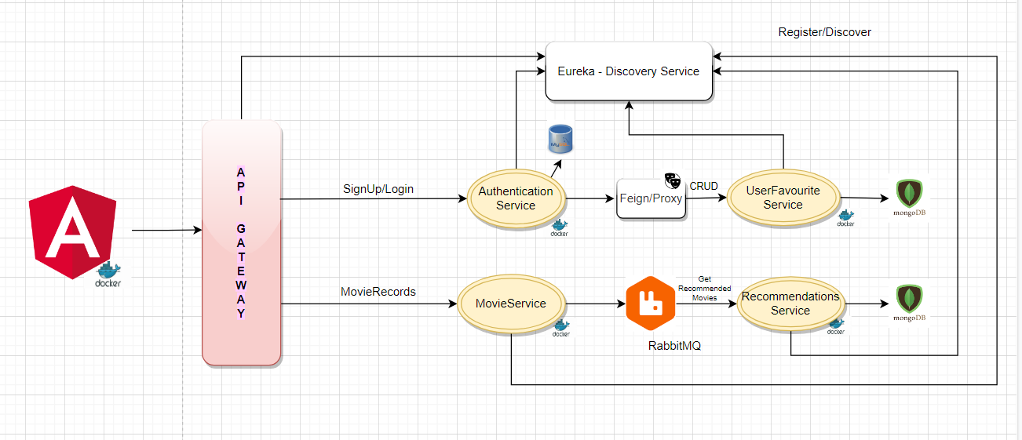
ARCHITECTURE DIAGRAM

Slide 4
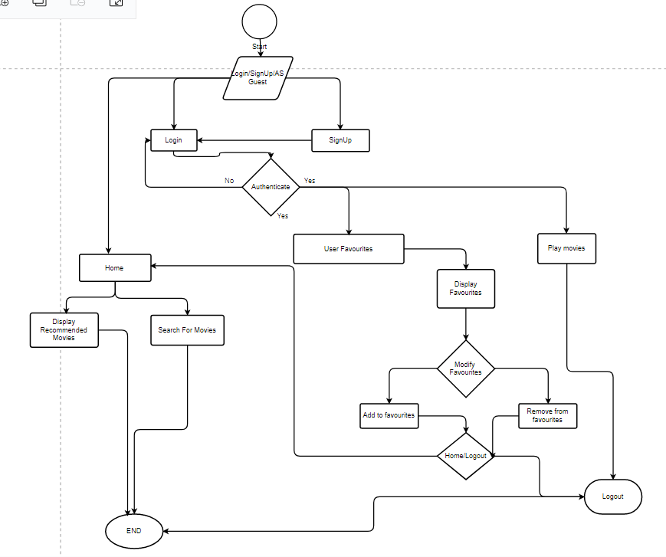
FLOW DIAGARM

Slide 5
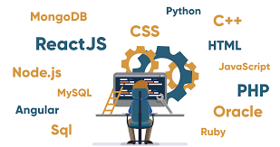








Tools and Technologies
Java
Junit+
Mockito
SpringBoot
RabbitMQ
Docker
GIT

Slide 6
MICROSERVICES
User Service
Favorite Service
Movie Service
Recommended Service
Discovery Service
API Gateway
Message Service
Feign Client
RabbitMQ

Slide 7
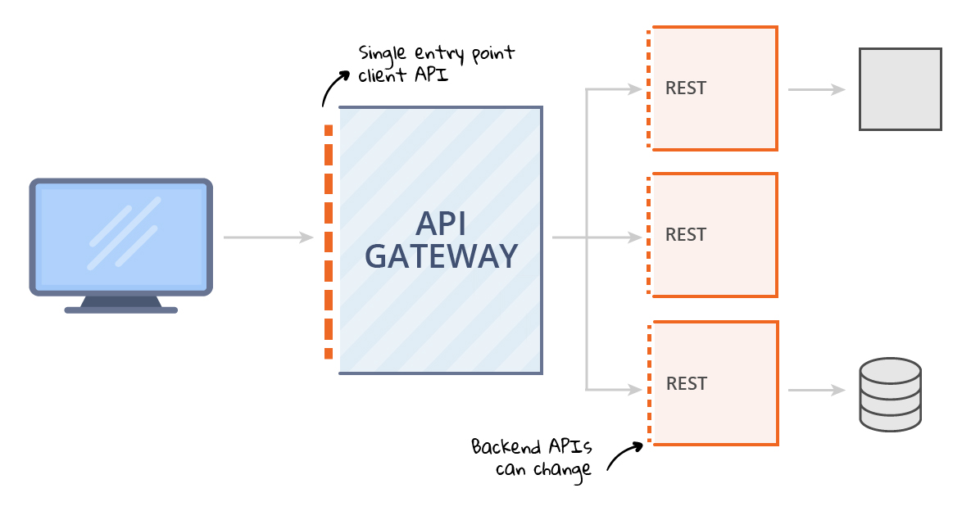
API GATEWAY
An API Gateway is a service that is the single-entry point into the system.
It is the tool that sits between and a collection to backend services.
Route to different API with mapped to different ports.

Slide 8
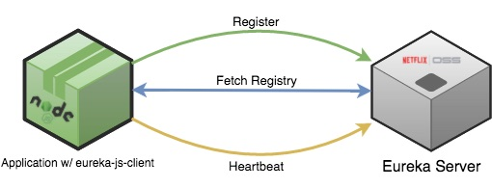
DISCOVERY SERVICE
Services are registered to the discovery server.
Service discovery service listens for the registered service when they start up.
There is a timeout period to assume that the service in offline.
Eureka Server.
Eureka client.

Slide 9
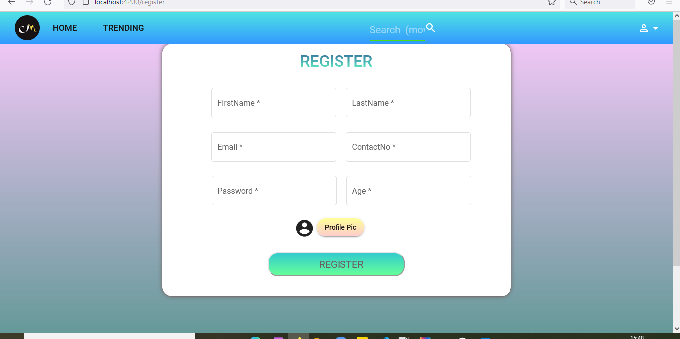
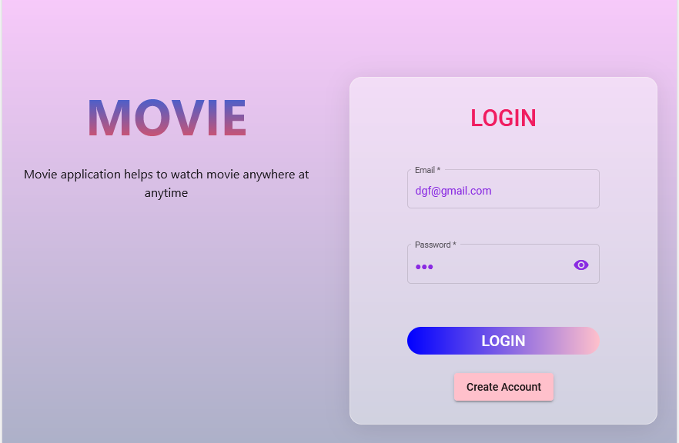
USER SERVICE
First time user can register /create his account.
Registered User can then login using email and password

Slide 10
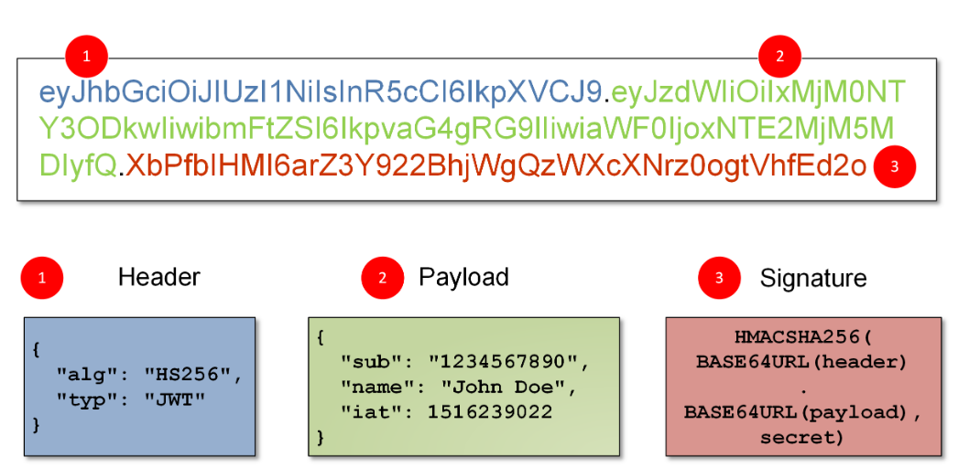
User Authentication
Using JWT (Json Web Token)
A compact and self-contained way for securely transmitting information between services as a JSON object.
Example of token signature

Slide 11
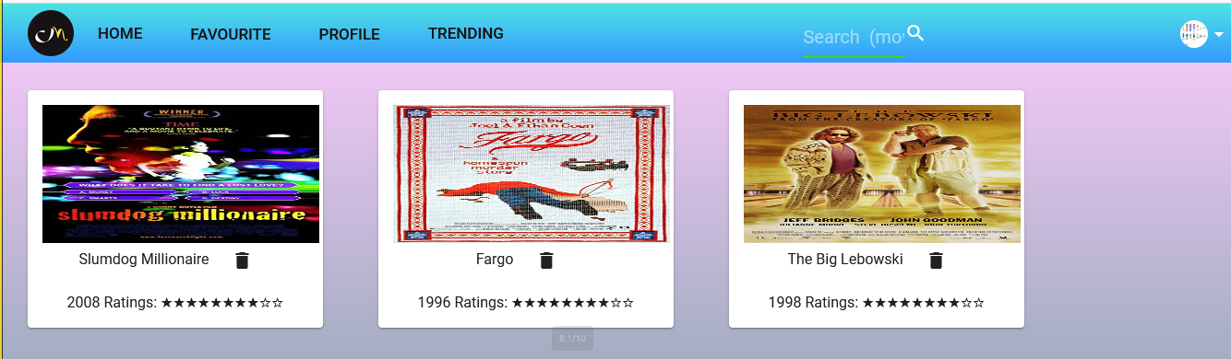
FAVORITE SERVICE
User can add his favorite list of movies.
User can view his favorite in dashboard.
User can remove from favorite list.

Slide 12
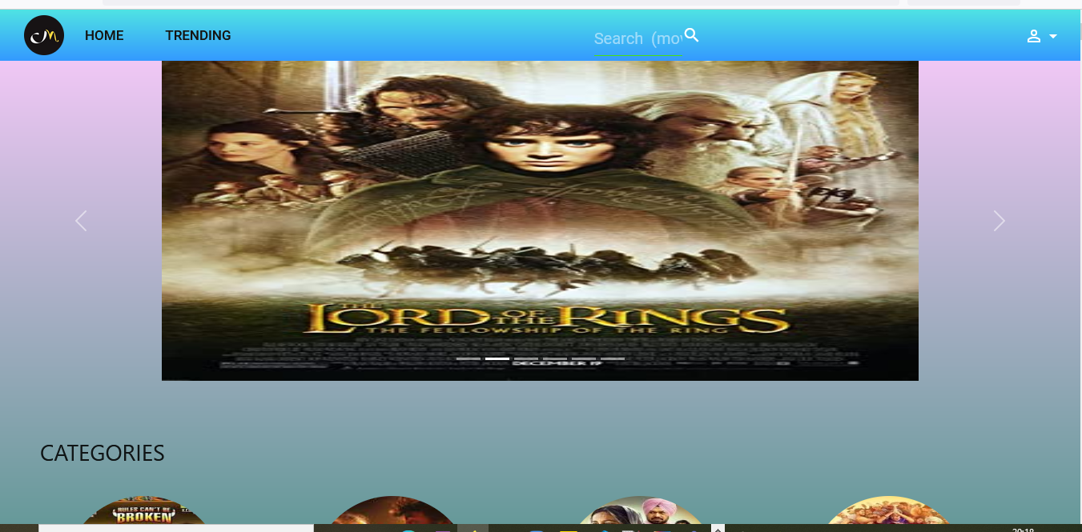
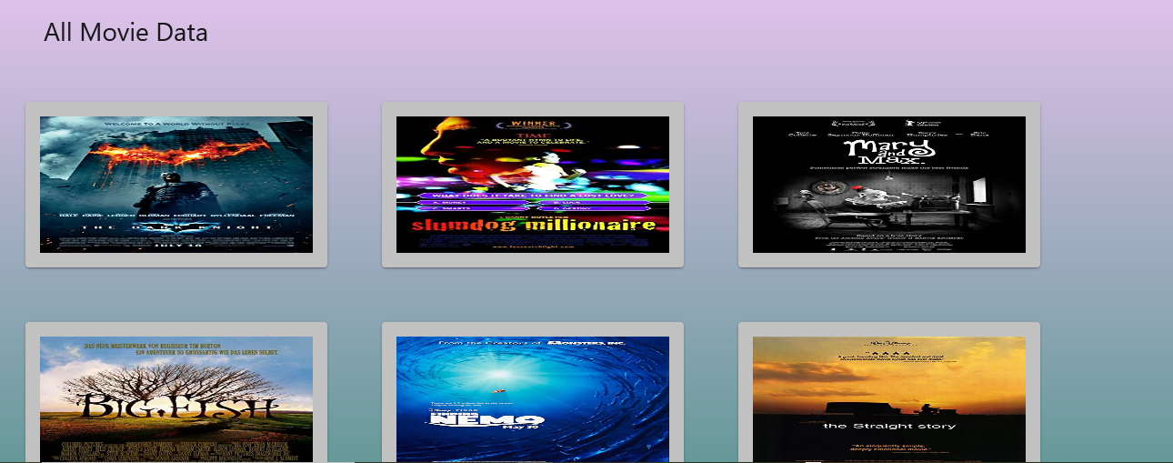
MOVIE SERVICE
Containing details about the movie i.e. Movie Name Director, Category, IMDB Rating, Poster of the Movie , etc.
Used to fetch all movie records.

Slide 13
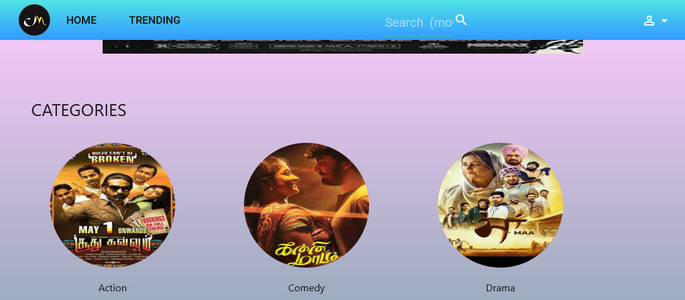
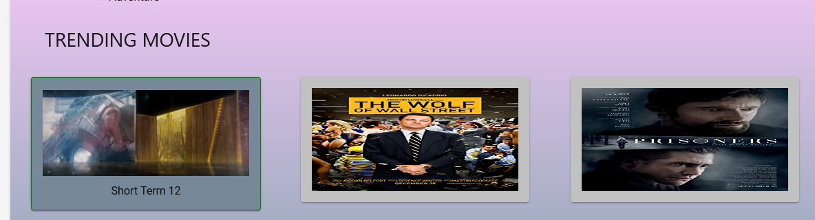
RECOMMENDED SERVICE
User can view in dashboard based on
Category
Allows user to choose any category and get movies related to it
Trending
Show all the movies currently most watched /in trend

Slide 14
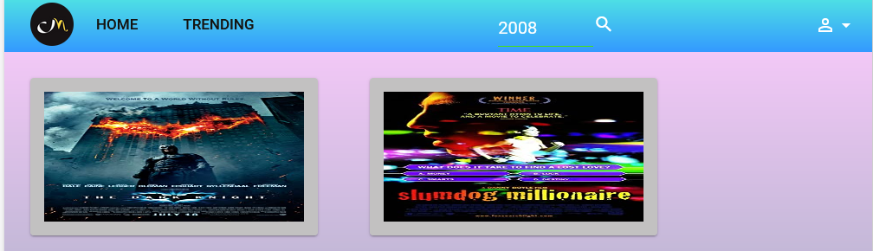
RECOMMENDED SERVICE
Using Smart Search
Either by Name of the movie
or Year of release
By Highest Rating
Highest Rated movies will be displayed in
carousel of home component

Slide 15
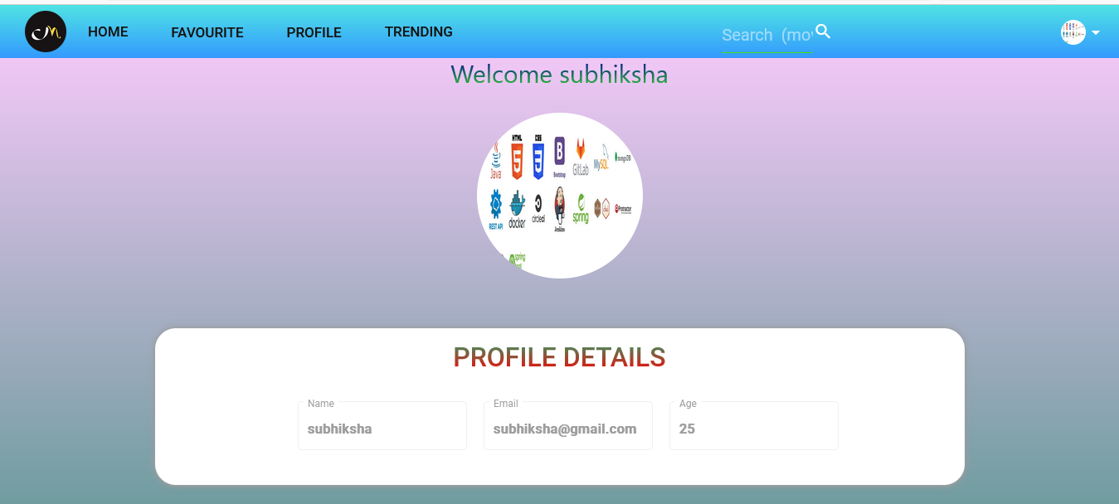
USER PROFILE
User details shown as a profile component after login is done
A Button of Deactivate Account is given for deleting account from database

Slide 16
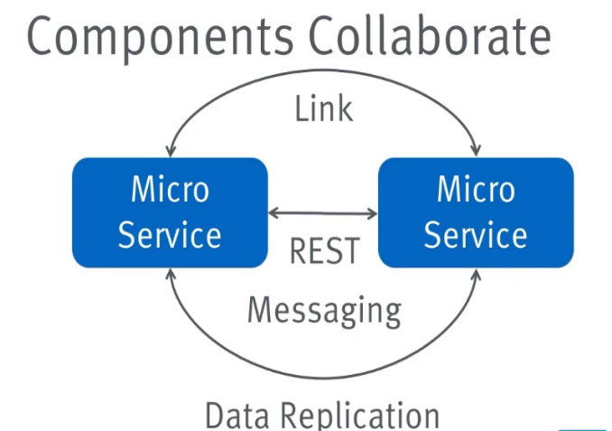
MICROSERVICES COMMUNICATION
Feign client(Proxy)
Communicates between userservice and favourite service
Synchronous communication
RabbitMQ
Communicates between movie service and recommended service.
Asynchronous Communication

Slide 17

